Slide 1
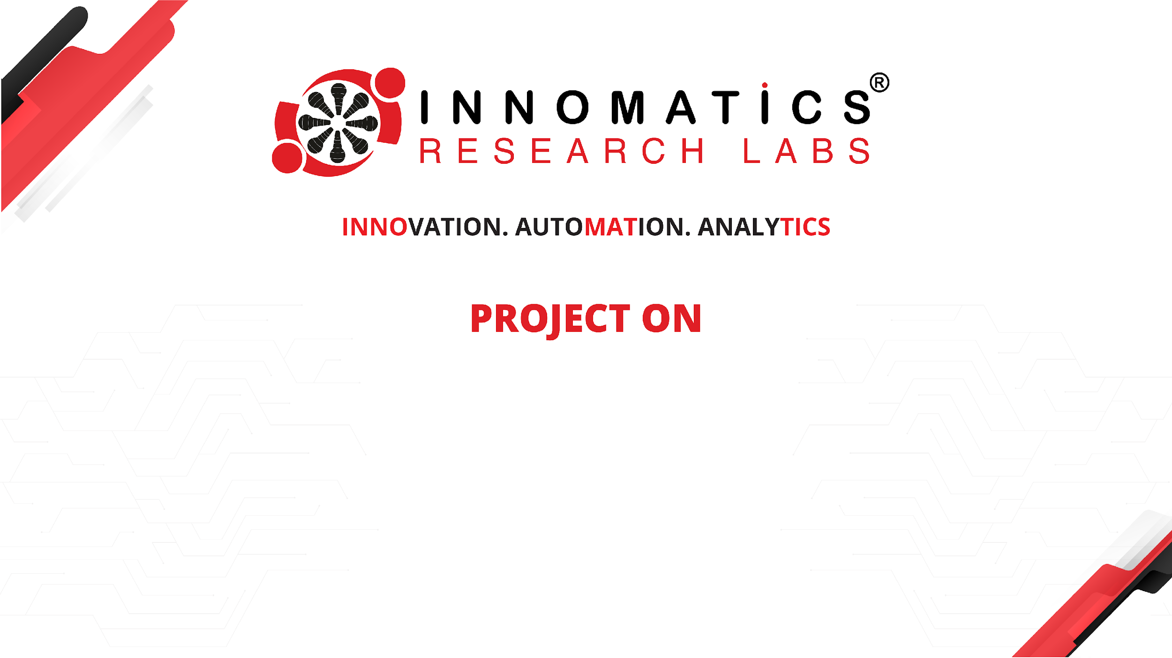
CODE REFACTORING AND BUG FIXING

Slide 2
ABOUT ME
I am Abilasha Doppalapudi , graduated in Computer Science Engineering from Nannapaneni Venkata Rao college of engineering and technology in the year 2023.
Learning data science is valuable due to its high demand and versatility across industries. It enables individuals to extract valuable insights, predict future trends, and automate processes for efficiency gains. Data science skills offer a competitive edge in various career paths, including data analysis, engineering, and science roles.
Furthermore, it contributes to addressing societal challenges by informing decision-making processes.
LinkedIn URL : linkedin.com/in/doppalapudi-abilasha
GitHub URL : https://github.com/Abhilasha201

Slide 3
ABOUT THE PROJECT
TASK
Debugging is an essential part of the development process, and Flask provides several tools to help you identify and fix issues in your application. In this guide, we will explore how to use Flask's built-in debugger and logging features to identify and fix common bugs.
When your code fails, you will likely be shown an error message that explains why it's failing. Take the time to understand the error message, as it often points to the problem clearly and even declares at what line it's happening.
Sometimes, restarting the debugger can help in identifying the bug. This is because it clears any breakpoints or variables that may have been set during the previous debugging session.

Slide 4

ABOUT THE PROJECT
To enable Flask's debugger, you can set the debug parameter to True when creating the Flask app.
With debugging enabled, Flask will provide more detailed error messages and a user-friendly debugger interface when an exception occurs.

Slide 5
DEBUGGING TIPS AND BEST PRACTICES
Here are some tips and best practices for debugging Flask applications:
Use logging to track the behavior of your application. This can help you identify issues before they become critical.
Use the interactive debugger to inspect the state of the application when an exception occurs.
When reporting a bug, provide as much information as possible, including the error message and any relevant log messages.
When debugging, try to isolate the issue to a specific part of the code. This can help you identify the root cause of the problem.
Use version control to track changes to your code. This can help you identify when a bug was introduced and revert changes if necessary.

Slide 6
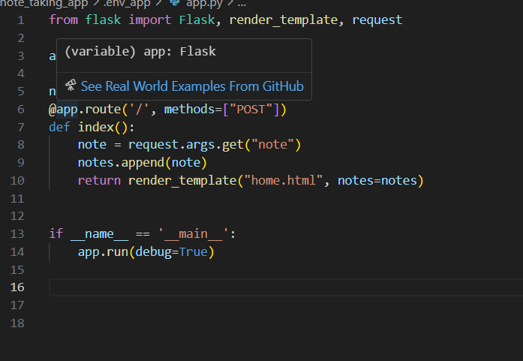
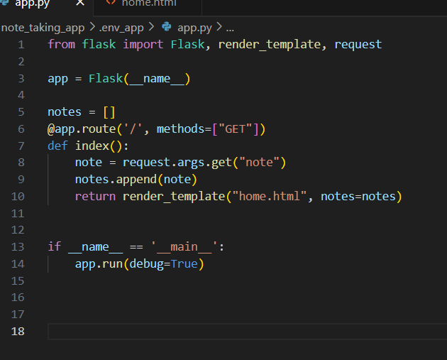
AFTER DEBUGGING
BEFORE
AFTER

Slide 7
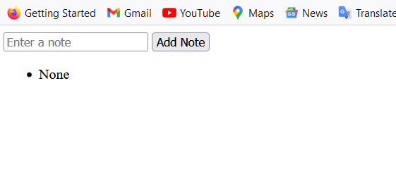
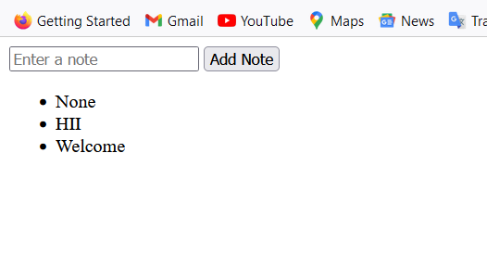
OUTPUT
HERE is the link for the display page http://127.0.0.1:5000
After we are giving data we can see the display page as

Slide 8
CONCLUSION
Debugging is an essential part of the development process, and Flask provides several tools to help you identify and fix issues in your application.
By using logging, the interactive debugger, and best practices, you can quickly and efficiently diagnose and fix bugs in your Flask applications.
To use the interactive debugger, your Flask application must be run in development mode.
When deploying your Flask application to a production server, it's important to disable debugging to prevent unauthorized access to sensitive information.
To improve your Flask application, consider using logging, error handling, version control, and web frameworks for database interactions and user authentication.
By following the experience points and implementing the suggested improvements, you can create a robust and efficient Flask application that is easy to debug and maintain.

Slide 9

THANK YOU

